Slide 1
UI COMPONENT LAYOUTS
https://github.com/tnt-summer-academy/Curriculum-2022/blob/main/Week%203/%5BENG3.4%5DView%20component%20layout.md
Created for Microsoft / TNTs

Slide 2
Learning objectives
TNTs will articulate some of the reasons for using a UI Component Library
TNTs will be able to install a UI Component Library and use a UI component in a React project
TNTs will learn how to layout a table with React using HTML and React Bootstrap
TNTs will understand the basics of adaptive layouts using React Bootstrap
TNTs will discover FluidUI Component Library
TNTs will practice experimenting with and troubleshooting in the browser

Slide 3
PART 0 CONTEXT

Slide 4
Goal
How to create components that can display a variety of data and distribute space dynamically?
Components are most useful when their contents are generated on the fly based on the data passed to them
How can we layout a web page
when we don't know what the final content of the page will be?
or when the content may continue to change as the user interacts with the page?
We will use tables to present hard coded data
We will debug along the way!
Notes:
We will look at other ways to display data in an organized way:
Flexbox
GridView

Slide 5
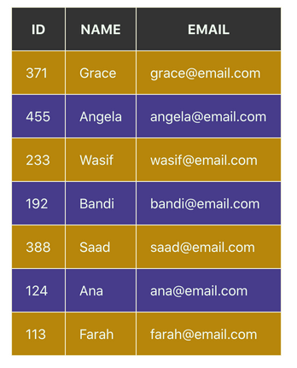
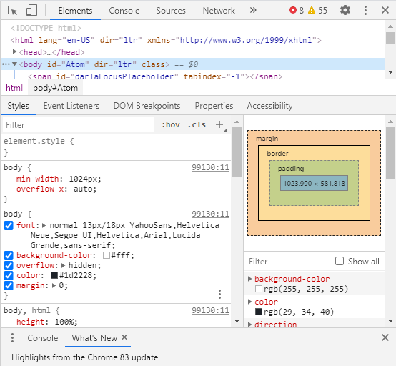
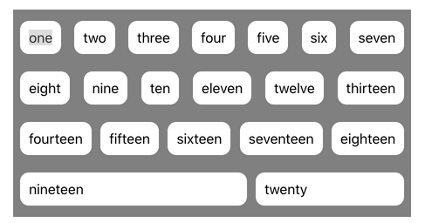

Slide 6
PART 1 DISCUSSION

Slide 7
Discussion
Even though the website https://nytimes.com displays as rows and columns, why is it not created as an HTML table?
What is a table?
Can you think of other web examples where they don't use a plain HTML table?
Hint: look at the web inspector of the websites you are visiting

Slide 8
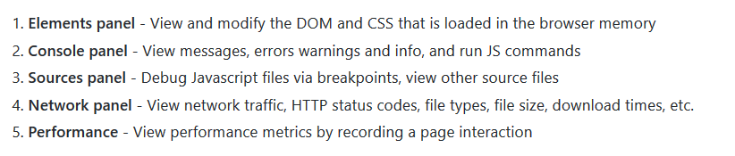
New York Times https://www.nytimes.com
Go to New York Times page
Tour the developer tools

Slide 9
New York Times https://www.nytimes.com
Find a table in the HTML
Go somewhere in the page and click on Inspect
Find an element. Change the HTML (Edit as HTML) and change the CSS

Slide 10
PART 2 SETTING UP

Slide 11
npm
Today we will need to do the following:
Bootstrap - npm install react-bootstrap bootstrap@4.6.0
We specifically want this version of react-bootstrap bootstrap, other versions may cause issues
Sass - npm install sass
This is the CSS compiler for Bootstrap
FluentUI - npm install @fluentui/react

Slide 12
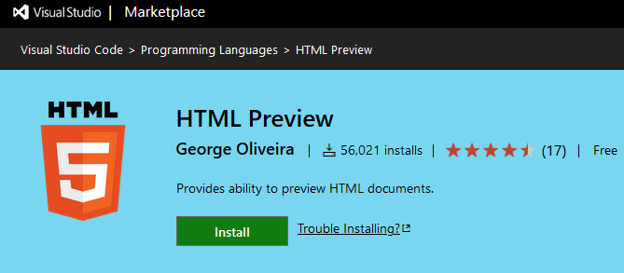
VS Code HTML Preview Extension
VS Code HTML Preview Extension
https://marketplace.visualstudio.com/items?itemName=george-alisson.html-preview-vscode

Slide 13
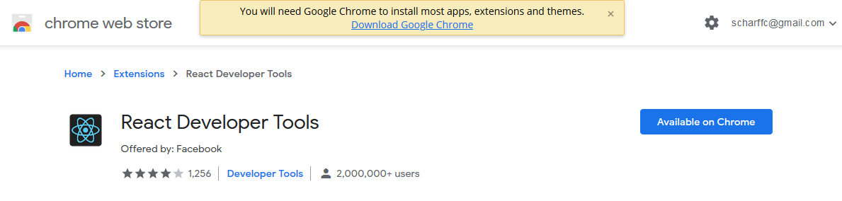
React Developer Tools

Slide 14
PART 3 REACT BOOTSTRAP

Slide 15
React-Bootstrap
React-Bootstrap is an external open-source library.
It provides and enables plug-ins for your projects for fast and responsive websites, with the React framework
React-Bootstrap uses components that are rendered in the browser. Previous versions used CSS.
Bootstrap is different from React-Bootstrap

Slide 16
Resources
Getting started with Bootstrap
Explore the existing components
Experiment with Bootstrap class presets (NOT REACT BOOTSTRAP)
Use the Component Sandbox

Slide 17
Exercise
Pick and choose a component from here and look at how to use it. Explore the API
https://react-bootstrap.github.io/components/alerts/

Slide 18
Code for today
Code
https://github.com/tnt-summer-academy/Samples/tree/main/Week_3/react-bootstrap-javascript
npm install --force
npm install react-router-dom@5.3.3 --force
npm install react-bootstrap bootstrap@4.6.0 --force
(because we will be using Bootstrap React)
npm install sass --force
(CSS compiler for Bootstrap)
npm install holderjs --force
(because we use some image placeholders)
npm install @fluentui/react --force
(because we will be using fluentui)
npm install react-async --save --force
(because we will fetch data online)
npm install --save react-lottie
(because we will use Lotties)
npm start

Slide 19
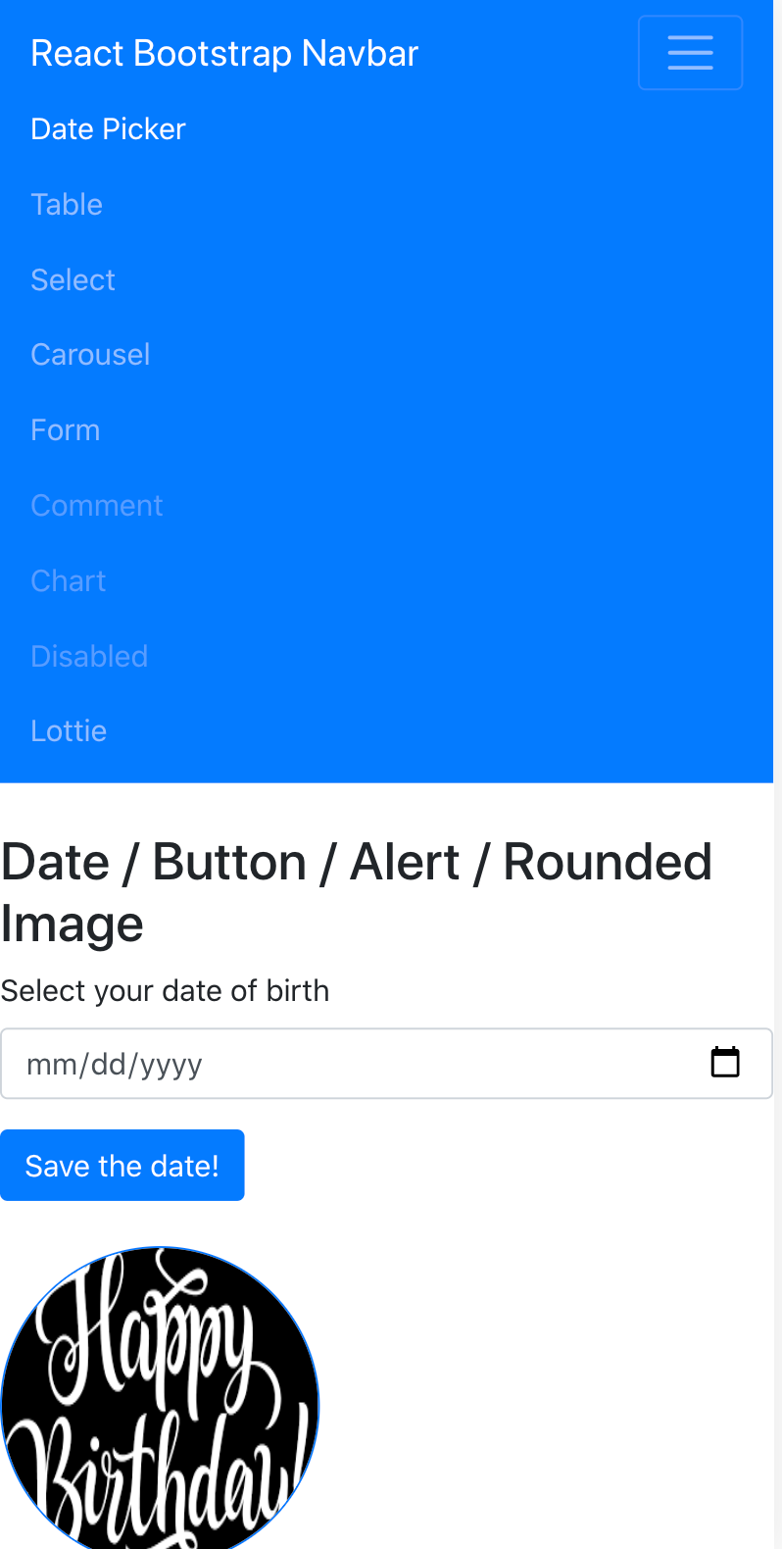
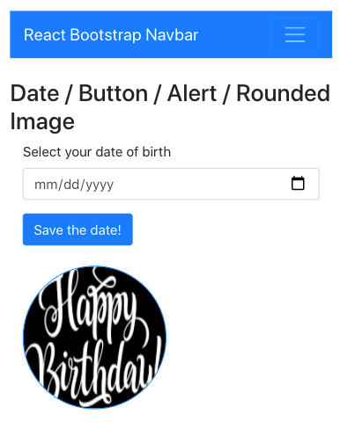
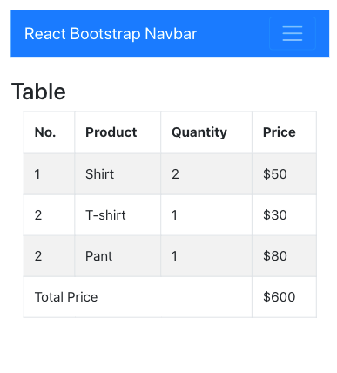

Slide 20
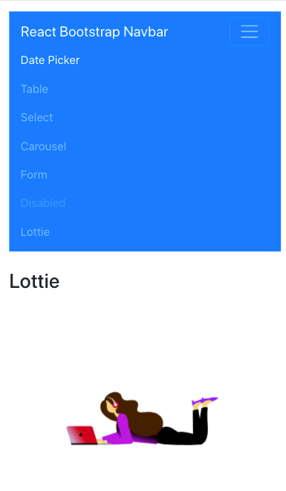
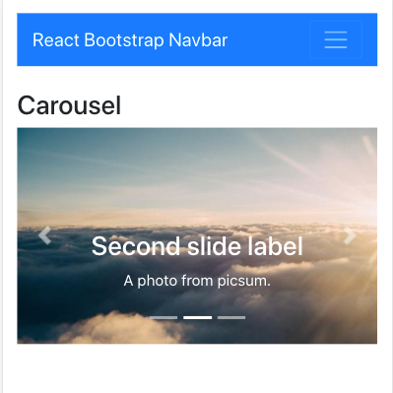


Slide 21
PART 4 REACT BOOTSTRAP TABLES

Slide 22
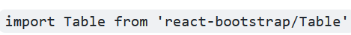
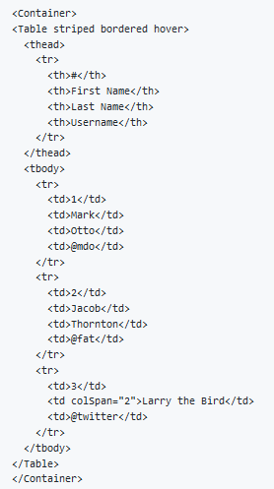
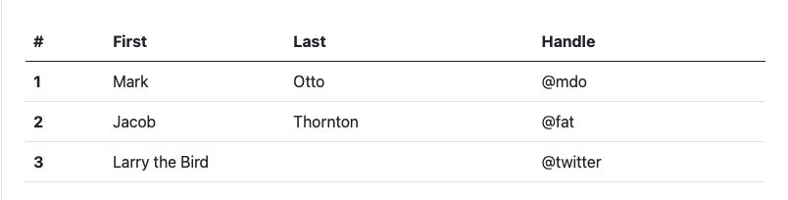
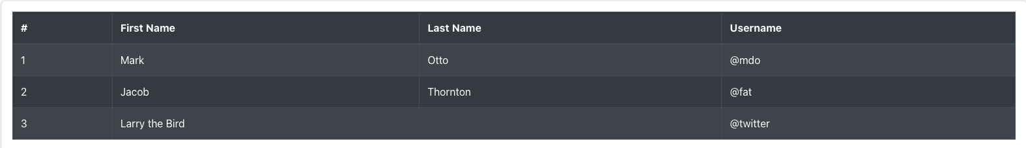
Table
import bootstrap/dist/css/bootstrap.min.css

Slide 23
PART 5 REACT BOOTSTRAP LAYOUTS
https://react-bootstrap.github.io/layout/grid/

Slide 24
Layouts
The React Bootstrap Layout is akin to the CSS Flexbox Layout, which is an efficient way to layout and distribute child items in ANY parent container allowing for each child item to either take up more or less space based on the number of items in the collection and the UI requirements.
This means as our screen gets bigger or smaller (think desktop to mobile), the items scale accordingly.

Slide 25
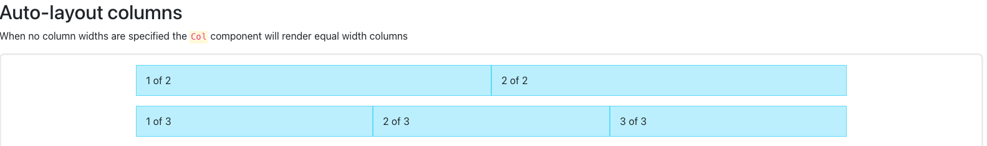
Auto-layout columns
Here is a basic example utilizing the <Col/> and <Row/> components. Notice that since we didn't specify a specific width, all columns are of equal widths, each taking the allowable space (12 spaces).
<Container>
<Row>
<Col>1 of 2</Col>
<Col>2 of 2</Col>
</Row>
<Row>
<Col>1 of 3</Col>
<Col>2 of 3</Col>
<Col>3 of 3</Col>
</Row>
</Container>
https://react-bootstrap.github.io/layout/grid/
Notes:
each taking 4 or 6 spaces within the 12 column space allowable

Slide 26
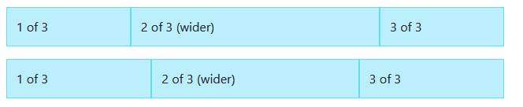
Setting one column width
Auto-layout for flexbox grid columns also means you can set the width of one column and have the sibling columns automatically resize around it.
<Container>
<Row>
<Col>1 of 3</Col>
<Col xs={6}>2 of 3 (wider)</Col>
<Col>3 of 3</Col>
</Row>
<Row>
<Col>1 of 3</Col>
<Col xs={5}>2 of 3 (wider)</Col>
<Col>3 of 3</Col>
</Row>
</Container>
https://reactstrap.github.io/components/layout/
Notes:
xs: It is used to denote the number of columns which will fit next to each other on extra-small devices

Slide 27
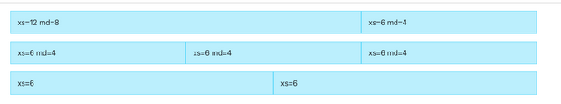
Responsive grids
<Container>
{/* Stack the columns on mobile by making one full-width and the other half-width */}
<Row>
<Col xs={12} md={8}>
xs=12 md=8
</Col>
<Col xs={6} md={4}>
xs=6 md=4
</Col>
</Row>
{/* Columns start at 50% wide on mobile and bump up to 33.3% wide on desktop */}
<Row>
<Col xs={6} md={4}>
xs=6 md=4
</Col>
<Col xs={6} md={4}>
xs=6 md=4
</Col>
<Col xs={6} md={4}>
xs=6 md=4
</Col>
</Row>
{/* Columns are always 50% wide, on mobile and desktop */}
<Row>
<Col xs={6}>xs=6</Col>
<Col xs={6}>xs=6</Col>
</Row>
</Container>
The Col lets you specify column widths across 6 breakpoint sizes (xs, sm, md, lg, xl and xxl). For every breakpoint, you can specify the amount of columns to span, or set the prop to <Col lg={true} /> for auto layout widths.
https://reactstrap.github.io/components/layout/

Slide 28
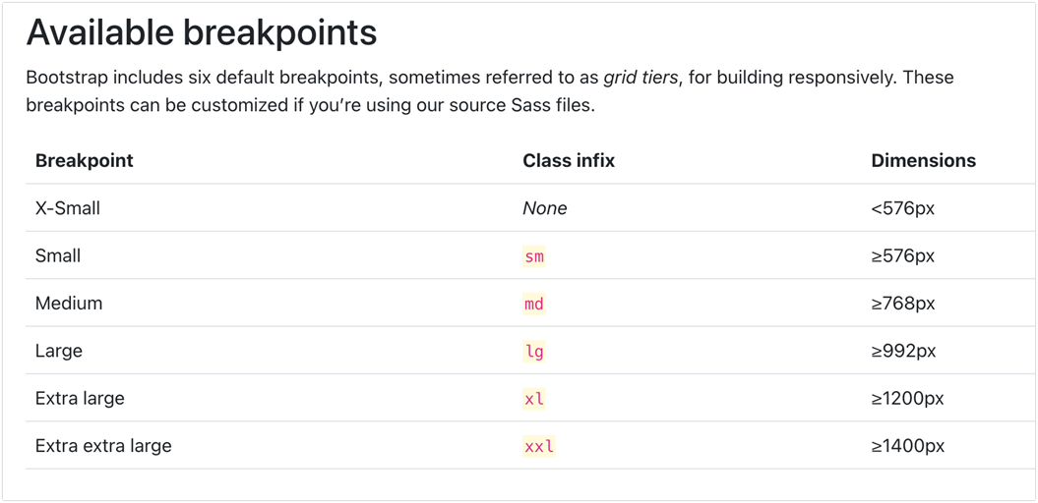

Slide 29
PART 6 FLUENTUI

Slide 30
FluentUI
Fluent UI is a UI component library available in two flavors: Fluent UI React and Fabric Core.
Fluent UI React is a front-end framework designed to build experiences that fit seamlessly into a broad range of Microsoft products. It provides robust, up-to-date, accessible components which are highly customizable using CSS-in-JS.
Fabric Core is an open-source collection of CSS classes and Sass mixins that give you access to colors, animations, fonts, icons and grid.
https://developer.microsoft.com/en-us/fluentui#/
The components are here https://developer.microsoft.com/en-us/fluentui#/controls/web

Slide 31
FluentUI
Installation
npm install @fluentui/react
Imports
import { [name_of_component] } from '@fluentui/react'
import { Stack } from '@fluentui/react'
You can use <Stack> to neatly "stack" children components of a parent component
Be careful, the code is in TypeScript in the FluentUi web site
You can try this tool:
https://extendsclass.com/typescript-to-javascript.html

Slide 32
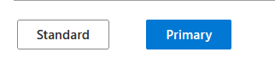
FluentUI Button
import Stack from “react-bootstrap/Stack”;
import { DefaultButton, PrimaryButton } from '@fluentui/react/lib/Button';
<Stack horizontal>
<DefaultButton text="Standard" />
<PrimaryButton text="Primary" />
</Stack>

Slide 33
PART 7 CHOOSING A UI COMPONENT LIBRARY

Slide 34
Choosing a UI Component Library
There are a large number of React UI component libraries to choose from, each with a different history, focus, strengths and limitations. Some things to look for include:
Built for React - some JavaScript front-end libraries can be used with React, but are not built for React. This can lead to integration issues and challenges with installation
Open Source Licensing - Not all libraries are open source or free to use. Look for MIT Licensing for the most flexibility. Note that some free libraries offer paid support or charge for custom themes.
Clearly Supported - Pay attention to when the library's GitHub repo was last updated; look for clear documentation, well-thought out examples, and sample projects.
Responsive, Accessible - frontend components libraries should include a focus on responsive design (adapting to different screen sizes), and accessibility (adapting to different user abilities).

Slide 35
PART 8 YOURSHARE

Slide 36
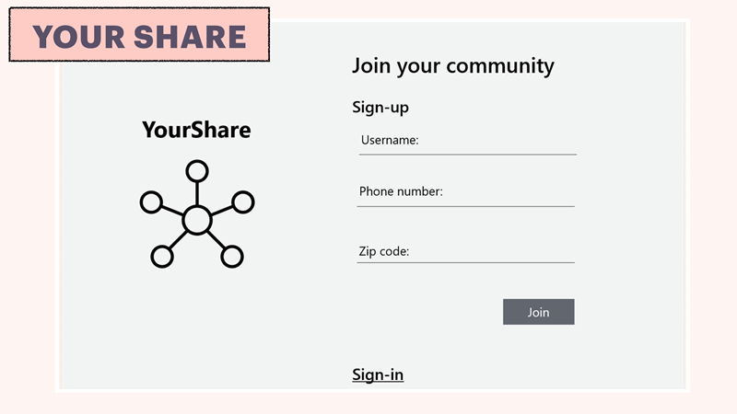

Slide 37
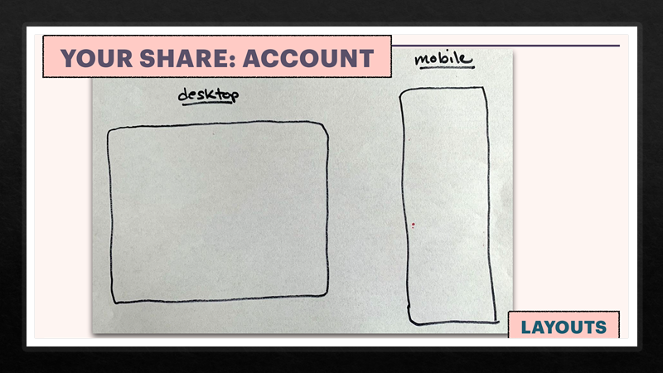

Slide 38
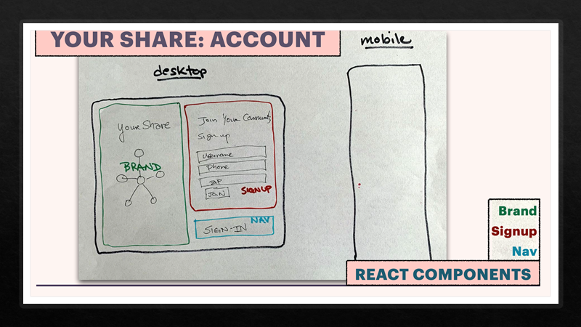

Slide 39
